Slide 1
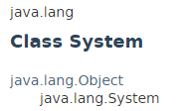


Java PrintStream class

